Slide 1
G2’s Drive System Primer – Acceleration and Gear Ratios
26 October 2015

Slide 2
What is a Robot Drive System?
An assembly of components and software which enables the robot to be in the right location and orientation to perform a task.
When the robot’s location, traction force, or kinetic energy perform an offensive or defensive task, the drive system is in effect also an actuator system.
99%+ of FRC robots have wheeled or treaded drive systems. Exceptions include conveyor robots (2015 Recycle Rush), legged robots (71 in 2002 Zone Zeal), and pure climbers (2013 Ultimate Ascent).

Slide 3
What limits acceleration?
There are three limiting factors for acceleration of a robot on level ground:
Coefficient of Friction (traction limited)
Limits to the torque available from the motors or other actuators (torque limited)
Keeping the robot upright (stability limited)
We shall look at each of these in turn

Slide 4
Traction Limited Acceleration
Drive force is obtained as a result of friction between the bottom of the wheels and the carpet (or other drive surface). The traditional calculation of frictional force is:
F = μN
Where F is the frictional force
μ is a constant coefficient of friction. It is approximately 1.0 for FRC kit tires on carpet, higher for some high performance treads, lower for hard or slick surfaces.
N is the force normal to the surface (for a horizontal floor this is the weight of the robot which is carried by this wheel)
There is debate as to whether or not μ is constant, but may be higher for lower for values of N. Those who have experimented have found it very nearly constant.
N
F

Slide 5
Torque Limited Acceleration
A CIM motor drawing 50A of current (25% over the breaker rating, which can be sustained for a number of seconds) generates about 0.67 ft-lb of torque.
This means that a 4-CIM, 4” wheel drive with no gearing can generate about 16 lb of force, which accelerates a 150 lb robot by about 3.4 ft/s each second; not very impressive – it would take over 5.6 seconds to run the length of an FRC field and crash into the far wall at 19 ft/s!
Most single-speed FRC robots gear down by 5:1-16:1 to improve torque. Robots with shifting gearboxes are likely to exceed these bounds.

Slide 6
Stability Limited Acceleration
A robot with a high center of gravity (or phenomenal acceleration) can accelerate at a rate which will result in the robot laying on its back.
Using a free-body diagram, and understanding that a robot is about to fall over when all of its weight is on the rearmost wheel, we can see that the maximum acceleration a over level ground is:
a=lg/h
Where l is the horizontal separation between the center of gravity and the axis of the “rear” wheel
g is the acceleration of gravity
h is the height of the center of gravity
h
r

Slide 7
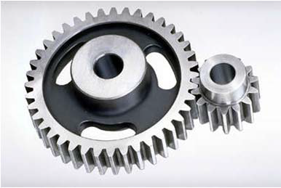
Gear Ratio
Very often, the output characteristics of a motor do not match those required; most commonly motors spin faster than desired, but do not produce enough torque.
Torque can be increased at a cost in speed reduction through different size gears, sprockets, or timing belt sheaves.
The sample at right shows a 40-tooth and a 16-tooth gear. Because the forces at the gear teeth are equal (Newton’s 3rd Law), the left gear has about 2.5x the torque but 0.4x the rotational speed of the right gear.

Slide 8
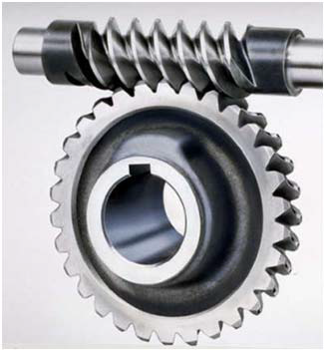
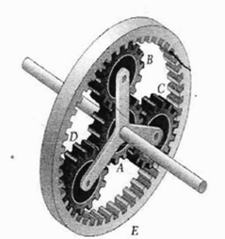
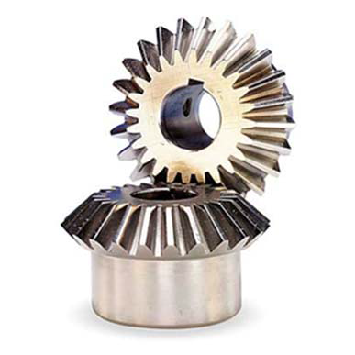
More on Gear Ratio
Similar effects can be achieved with chain and timing belts. Note that every level of reduction causes some energy to be lost as heat due to friction. The speed of the input of a drive train to its output is known as the gear ratio, whether the result was generated by gears, chain, belt, or a combination of effects. (Previous sample was 2.5:1.)
Bevel gear (change direction, possibly gear ratio)
Worm gear (direction and gear ratio)
Planetary gear box (Gear ratio only)

Slide 9
Multistage/Shifting Gearboxes
Gearboxes may have multiple stages (the gear ratios multiply), especially to achieve ratios below about 5:1.
When good acceleration and great top speed, or decent top speed and really high torque (for pushing) are both needed, shifting gearboxes are used. COTS shifters typically have a range of 2.5 – 4.0 between the high and low gear ratios.

