Slide 1
Bumper Number Template
Isaac Rife
Killerbees Team 33

Slide 2
Team Number Template
Using this template is not mandatory, but may be helpful for some 4 digit teams with relatively short bumpers.
Several teams have asked questions in the Q&A about trying to fit 4 digit numbers on minimum length bumper segments.
While legible numbers are mandatory for judges and event staff, they are also highly recommended to improve scout-ability and thus likelihood of being picked.

Slide 3
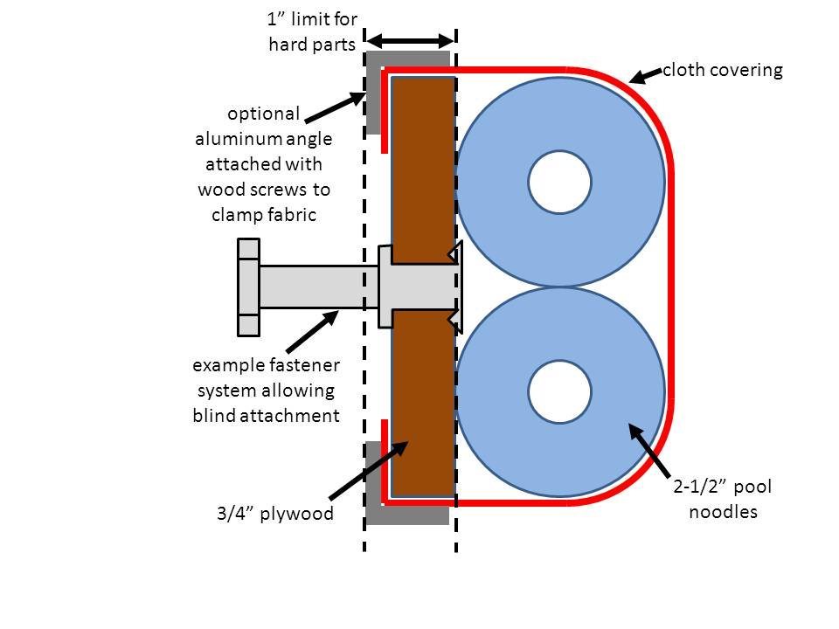
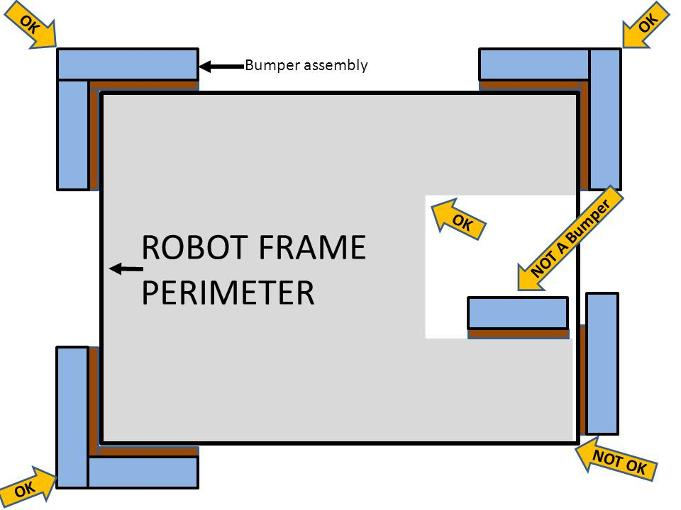
Excerpts from Bumper Rules & Number Requirements
[R27] Robots are required to use Bumpers to protect all exterior vertices of the Frame Perimeter. For adequate protection, at least 8 in. of Bumper must be placed on each side of each exterior vertex (see Figure 4‑1, Figure 4‑2, and Figure 4‑3).
[R34] Each Robot must be able to display red or blue Bumpers to match their alliance color.
[R35] Teams shall display their team number on the Bumpers in four locations at approximately 90° intervals around the perimeter of the Robot. The numerals must be at least 4 in. high, at least ¾ in. in stroke width, and be either white in color or outlined in white. Team numbers must be clearly visible from a distance of not less than 100 ft, so that judges, referees, and announcers can easily identify competing Robots.
Derived Requirements: The minimum corner bumper length from these rules may be derived to be approximately:
8” Min length (of frame)+3/4” Plywwod+2 ½” Pool Noodle or: 11 ¼” in length.
Depending on construction, 1 ¼” may start to wrap around, therefore 10” of flat length is reasonable assumption.

Slide 4
10”
0.8”
0.75”
0.6”
0.75”
0.5”
4”
5”
Basic dimensions of minimum bumper area with blocks for wide 4 digit numbering. Block heights are 0.8” tall which therefore will excede minimum stroke width of 0.75”, and blocks for vertical strokes are 0.75” wide meeting the minimum stroke width. Spacing between numbers is 0.5” to allow for legibility.

Slide 5
Copy and Paste in corners to achieve different looks.

Slide 6
Copy and Paste in corners to achieve different looks.

Slide 7
Example: 3333 with different possible formats.

Slide 8
2,3,5,6,8 can often be difficult to distinguish with many fonts.

Slide 9
4 and 9 can also be difficult. Print your numbers, set them vertically on the ground, walk back 33 paces. Are they easy to read at 100 feet? If not, keep working.

