Slide 1
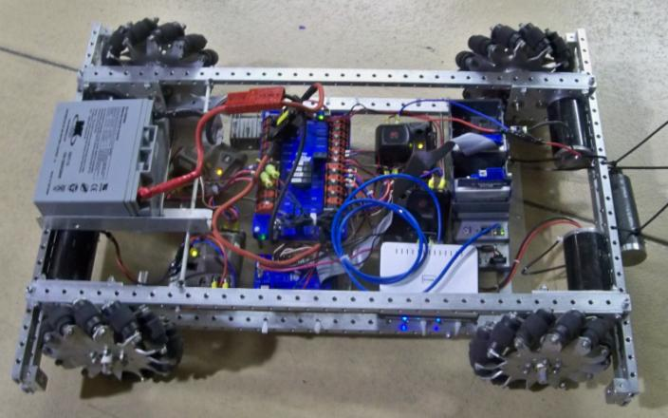
FRC Team 2337 Plate/Rail Chassis Design
Fully functioning prototype making its debut. Featuring ½ X 1 X 1/8 top and bottom rails, 3.5 X 5.0 motor and shaft plates, narrowed and lightened gears and a bunch of ¼”holes. Don’t know who put those 2008 Mecanum wheels on there.
This is one of several 4 Wheel Drive Variants
Motor and Shaft Plates were cut, removing 1” out of the center to make two identical plates which were bolted to ends of rails. Basically a two shaft NanoTube with KoP rails instead for mounting all the other stuff.

Slide 2
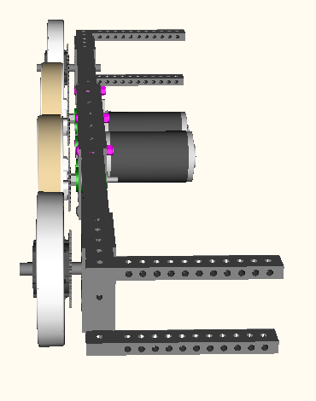
FRC Team 2337 Plate/Rail Chassis Design
8 Wheel Drive Variant
Design Notes
We wanted an all gear drive to power center wheels, after having the chain break on one of our alliance partners in a Semi Final match and our backup partner wasn’t very good. This variant has an idler gear between the motors, tying them together. Plan is to use all aluminum TB output gears with ½ to 3/8 hex shaft adapters on counter shafts to reduce weight

Slide 3
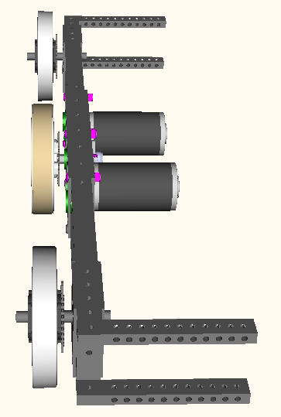
FRC Team 2337 Plate/Rail Chassis Design
6 Wheel Drive Variant
Design Notes
To make this variant we simply change motor position and move output shaft to center. Outer wheels are driven off center. It is shown in dead axle arrangement. We have designed a live axle, which requires a modification to the chain adjustment scheme.

Slide 4
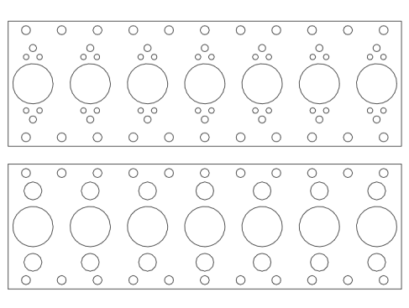
FRC Team 2337 Plate/Rail Chassis Design
Rail Section, Motor and Shaft Plates
Rail section shown with holes on same centerlines
Motor plate shown with all the holes
Shaft plate shown with all the holes

Slide 5
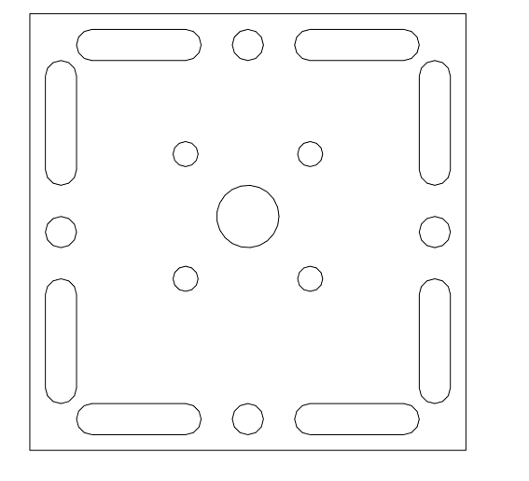
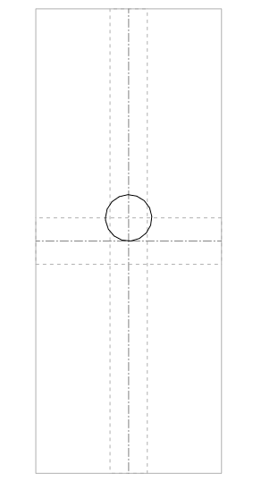
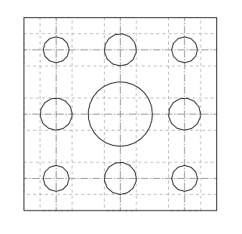
FRC Team 2337 Plate/Rail Chassis Design
Axle Plate, Axle Block and Adjuster Block

Slide 6
FRC Team 2337 Plate/Rail Chassis Design
Summary
This was an ambitious and time consuming off season project, completed for potential use during the 2011 and future seasons. Our goal is not the known as that team who use only Mecanum wheels every year. As with most designs, these screen shots represent the working design at a moment in time.
Rails – ½” X 1” X 1/8 wall aluminum tubing with ¼” through holes. We made two versions, one with top and side holes on same centerline and other with top and side holes ½” apart.
Motor Plate – 3.5 X 11 X 3/16 – Motor/Bearing holes are 1.602 on center, same as a ToughBox
Shaft Plate – 3.5 X 11 X 1/8 – Holes same center as MP
Axle Plate – 3.5 X 3.5 X 1/8 – Center hole ½” and is offset 1/8” to provide rock or when turned provide 0 offset
Axle Block – 1 ½ X 1 ½ X 1 - ½” center hole
Adjuster Block – 1 X 1 X 2.5 - Drilled and tapped on ends with ¼” holes in center and offset 1/8”

